Slide 1
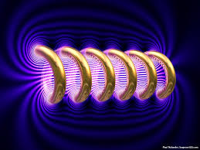
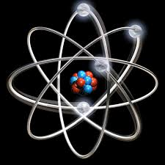

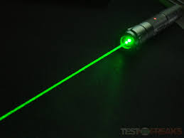

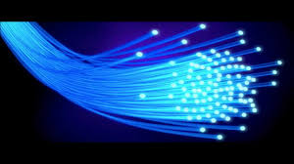
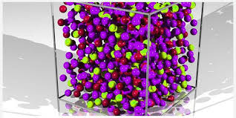
Engineering Physics
PHY-109
Solid State Physics-3
ELECTROMAGNETIC THEORY
QUANTUM MECHANICS
LASER
WAVES
Dr. Jeeban Pd Gewali
Department of Physics
Lovely Professional University
Phagwara, Punjab-144411
SOLID STATE PHYSICS
FIBER OPTICS

Slide 2
Syllabus
Free electron theory (Introduction).
Diffusion and drift current (qualitative).
Fermi energy, Fermi-Dirac distribution function.
Band theory of solids - formation of allowed and forbidden energy bands.
Semiconductors and insulators, Fermi level for intrinsic and extrinsic semiconductors.
Direct and indirect band gap semiconductors.
Concept of effective mass - electrons and holes.
Hall effect (with derivation).

Slide 3
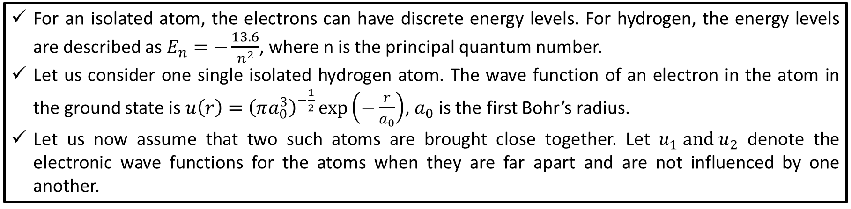


Band Theory of Solids
For an isolated atom, the electrons can have discrete energy levels. For hydrogen, the energy levels are described as $E_{n}=−\frac{13.6}{n^{2}}$, where n is the principal quantum number.
Let us consider one single isolated hydrogen atom. The wave function of an electron in the atom in the ground state is $u\left(r\right)={\left(πa_{0}^{3}\right)}^{−\frac{1}{2}}\exp\left(−\frac{r}{a_{0}}\right)$, $a_{0}$ is the first Bohr’s radius.
Let us now assume that two such atoms are brought close together. Let $u_{1} and u_{2}$ denote the electronic wave functions for the atoms when they are far apart and are not influenced by one another.
U₁
U₂
U₁
B
A
B
A
U₂
As the separation between the atoms is decreased, the wave functions $u_{1}$ and $u_{2}$ overlap and the resultant electronic wave functions may be $u_{1}+u_{2}$ or $u_{1}−u_{2}$.
$$u_{1}+u_{2}$$
U₁
B
A
B
A
$$u_{1}−u_{2}$$
U₂

Slide 4
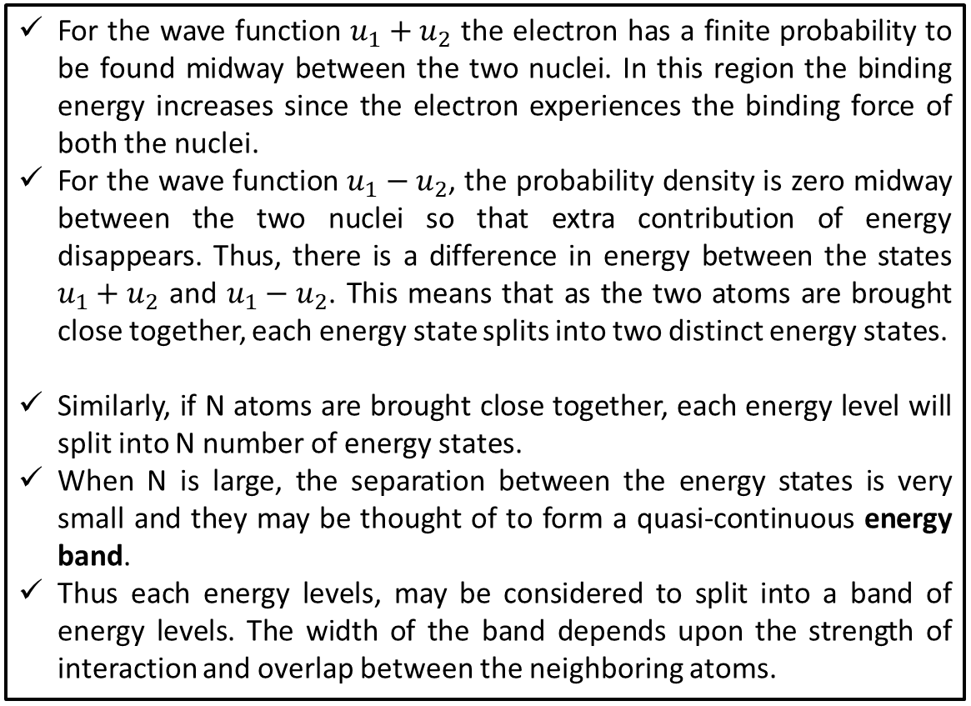
Band Theory of Solids
U₁
B
A
B
A
U₂
For the wave function $u_{1}+u_{2}$ the electron has a finite probability to be found midway between the two nuclei. In this region the binding energy increases since the electron experiences the binding force of both the nuclei.
For the wave function $u_{1}−u_{2}$, the probability density is zero midway between the two nuclei so that extra contribution of energy disappears. Thus, there is a difference in energy between the states $u_{1}+u_{2}$ and $u_{1}−u_{2}$. This means that as the two atoms are brought close together, each energy state splits into two distinct energy states.
Similarly, if N atoms are brought close together, each energy level will split into N number of energy states.
When N is large, the separation between the energy states is very small and they may be thought of to form a quasi-continuous energy band.
Thus each energy levels, may be considered to split into a band of energy levels. The width of the band depends upon the strength of interaction and overlap between the neighboring atoms.
2s
Energy
1s
Distance between the atoms

Slide 5
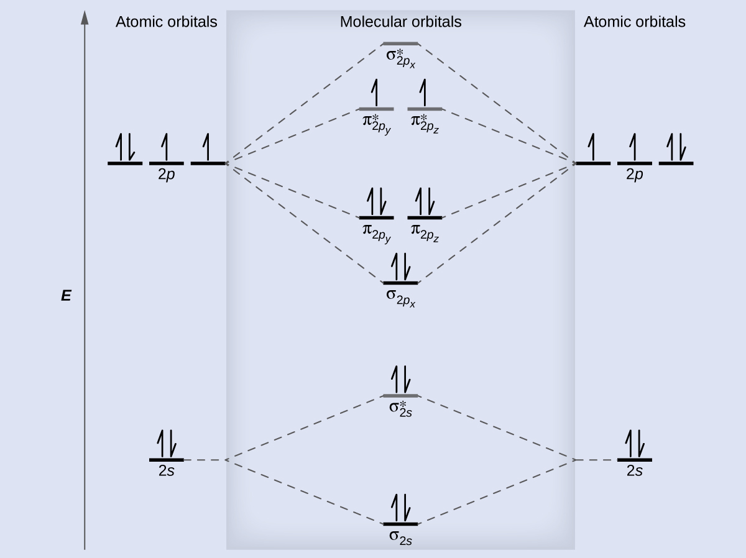
Molecular Orbitals

Slide 6
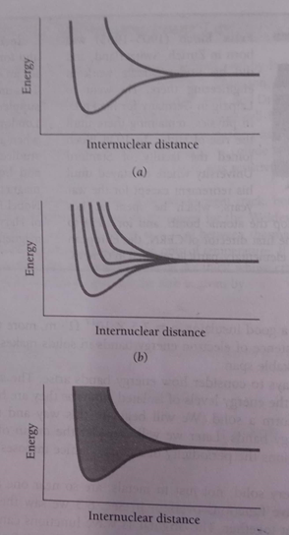
The 3s level is the highest occupied level in a ground state sodium atom.
(a) When two sodium atoms come close together, their 3s levels initially equal, becomes two separate levels because of the overlap of the corresponding electron wave functions.
(b) The number of new levels equals the number of interacting atoms.
(c) When the number of interacting atoms is very large, as in solid sodium, the result is an energy band of very closely spaced levels.

Slide 7
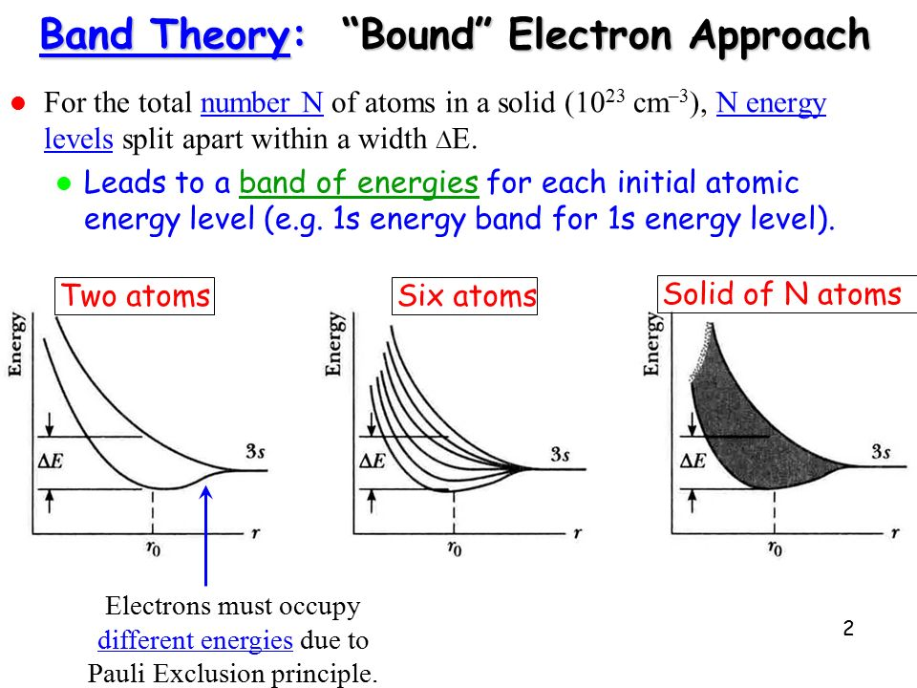

Slide 8
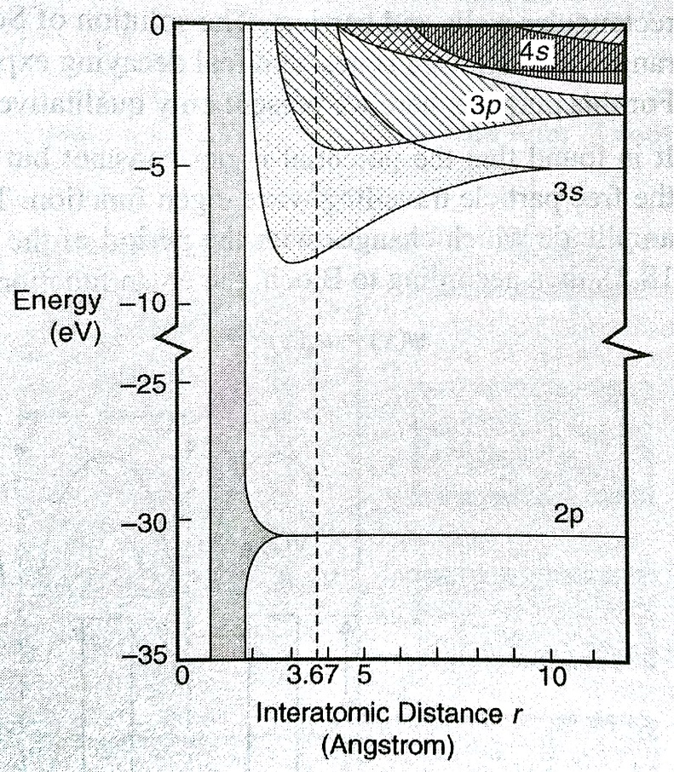
Formation of Allowed and Forbidden Bands
The electronic configuration of sodium is plotted in the side figure.
The dashed vertical line represents the equilibrium interatomic distance.
It is clear from the figure that the band overlaps as the interatomic distance decreases.
The allowed band corresponding to the inner subshell e.g. 2p are extremely narrow and does not begin to split until the interatomic distance r becomes less than the value actually found in the crystal.
As we move towards the high energy states, the energy of the electrons become larger and also the region in which they can mover become wider. Since they are also affected more by the nearby ions, it is seen that the bands become progressively wider for the outer occupied subshells and also for the unoccupied subshells of the atom in its ground state.
An electron in a solid can occupy only energy that falls within these energy bands. The overlapping of the bands depends on the structure of the solid. If the band do not overlap, then the intervals between them represents energies which the electrons in he solid cannot occupy. These intervals are called the forbidden bands or energy gaps.

Slide 9
Na(Sodium) Versus Mg(Magnesium)
The electronic configuration of sodium is 1s² 2s² 2p⁶ 3s^{1.} In sodium (a good conductor) there are 2 electron states per atom in the 3s shell. However only one of them is filled with a single valence electron. As a result the 3s shell is only half filled. The electron is free to change its energy within the 3s band. This allows the electrons to pick up a kinetic energy from an applied electric field leading to a drift velocity generating current that makes Na a good metallic conductor. | Magnesium has an electronic configuration 1s² 2s² 2p⁶ 3s². Thus it has a filled 3s shell and on its own it would not allow for the electrons to gain energy, if the 3p band was separated by a gap from the 3s band. In magnesium however, the 3s and3p band overlap in energy. The 3p band can accommodate 6 electrons. Thus jointly the 3s and 3p orbitals form a band that can accommodate 8 electrons out of which only 2 are there. Thus the conduction band is only 25% filled and hence Mg is also a good conductor of electricity.

Slide 10
Band in Insulators
Carbon
In insulators the electron states in the valence band are completely filled.
The next higher available energy band, the conduction band, is separated from the valence band by a band gap.
In an insulator the band gap is large enough in energy so that electrons are not thermally excited across it.
Carbon (C, 1s² 2s² 2p²) is an insulator even though it has a only partially filled p band.
At some intermediate C-C separation an overlapping s-p band accommodating 8N electron states is formed.
At the equilibrium separation however the band is split into two bands accommodating 4N electrons (hybridization) each that are separated by an energy gap of 6 eV making Carbon (diamond) an insulator.

Slide 11
Band in Semiconductors
similar reasoning applies to silicon (Si, 1s² 2s² 2p⁶ 3s² 3p²).
For Si the energy gap is only 1 eV.
At room temperature a noticeable number of electrons are thermally excited across the energy gap, where states are available and electrons can gain energy and conduct current.
Because of the intermediate conductivity such materials are called semiconductors
Valence Band:-The band of energy occupied by the valence electrons is called the valence band. The valence band is the highest occupied band.
Conduction Band:-The conduction band is normally empty and may be defined as the lowest unfilled energy band. In the conduction band, electrons can move freely and are generally called conduction electrons.

Slide 12
What is so special about the valence and conduction band?
In ideal cases the conduction band is empty and the valence band is fully occupied. Hence, when the electrons move from the valence band to the conduction band, gaining some energy from the external source, the electron become free to roam about in the conduction band. This is why conduction band is responsible for the conduction of electricity. The electrons can occupy any energy state within this conduction band of energies.
Pauli's exclusion principle however, forbids two electrons to occupy same energy state. If one electron takes one energy state, then other electrons in the same band now have less number of unoccupied states to move to.
So, if more electrons are brought to the conduction band, less freedom each of them has, to move around within this band. If it becomes totally full, they are all again "fixed" at their current energy states and the freedom is lost. Thus, once again some amount of energy has to be added to make a jump to even higher band to reach freedom again.
At this point, the recently full conduction band has become "the new" valence band. And "the new" conduction band is the nearest band higher up (energy-wise). There is thus no difference between valence and conduction bands other than how much occupied they are.
https://physics.stackexchange.com/questions/266114/what-is-it-about-the-conduction-band-of-a-material-that-is-distinct-from-the-v

Slide 13
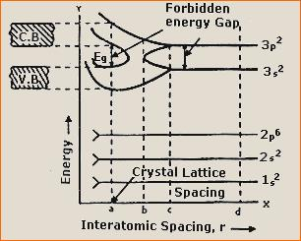
Band Formation in Silicon
In a solid, many atoms are brought together, so that the split energy levels form essentially continuous bands of energies.
Each isolated silicon atom has an electronic structure
1s² 2s² 2p ⁶ 3s² 3p² in the ground state.
Each atom has available two Is states, two 2s states, six 2p states, two 3s states, six 3p states, and higher states.
If we consider N atoms, there will be 2N, 2N, 6N, 2N, and 6N quantum states of type Is, 2s, 2p, 3s, and 3p, respectively.
As the interatomic spacing decreases, these energy levels split into bands, beginning with the outer (n = 3) shell.
As the "3s" and "3p" bands grow, they merge into a single band composed of a mixture of energy levels. This band of "3s-3p" levels contains 8N available quantum states.

Slide 14
Band Formation in Silicon
As the distance between atoms approaches the equilibrium interatomic spacing of silicon, this band splits into two bands separated by an energy gap Eg.
The upper band (called the conduction band) contains 4N quantum states, as does the lower (valence) band.
Thus, apart from the low-lying and tightly bound "core" lev­els, the silicon crystal has two bands of available energy levels separated by an energy gap E_{g} wide, which contains no allowed energy levels for electrons to occupy.
This gap is sometimes called a "forbidden band," since in a perfect crystal it contains no electron energy states.

Slide 15
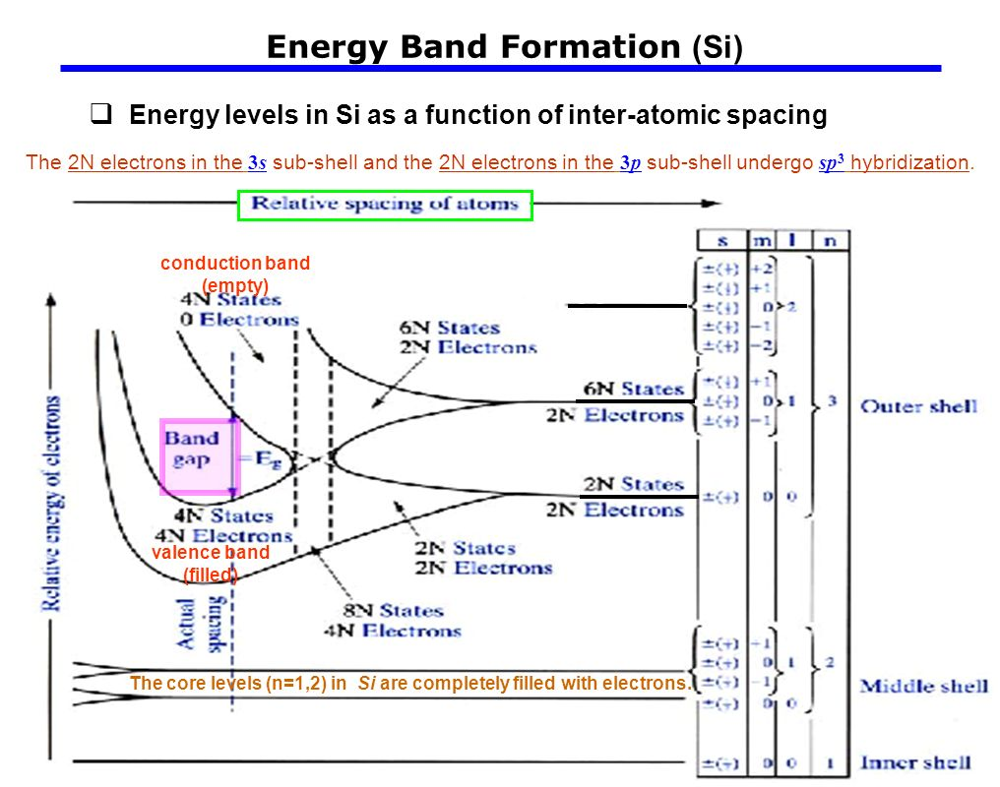
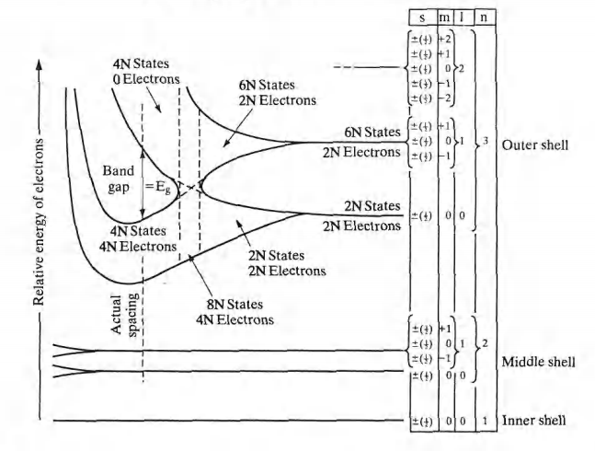
Band Formation in Silicon

Slide 16
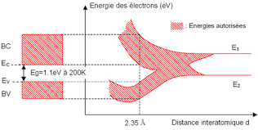
Formation of bands in Silicon
The core levels (n = 1,2) in Si are completely filled with electrons.
At the actual atomic spacing of the crystal, the 2N electrons in the 3s subshell and the 2N electrons in the 3p subshell undergo sp² hybridization, and
ll end up in the lower 4N quantum states (va­lence band), while the higher-lying 4N quantum states (conduction band) are empty, separated by a band gap.

Slide 17
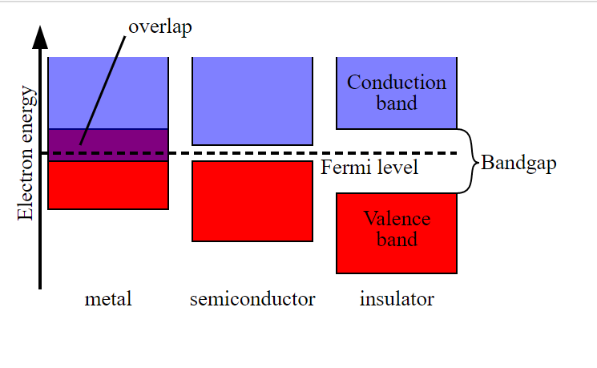
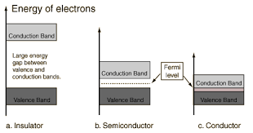
Band gap in the solids

Slide 18
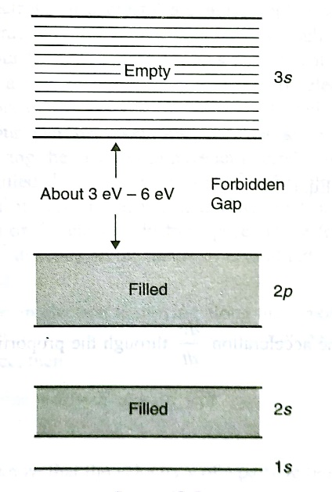
Insulators
The band formation for the insulators is as shown in the figure.
The forbidden gap between the highest filled band and the lowest empty band is very wide and is about 3 eV to 6 eV.
Very few electrons from the filled band reach the empty band even if we thermally excite them or apply an electric field to them.
The Pauli’s exclusion principle restricts the electrons from moving in the valence band. Hence a free electron current cannot be obtained for the insulating material.
Ex- diamond, quartz, ZnO, Agcl etc.

Slide 19
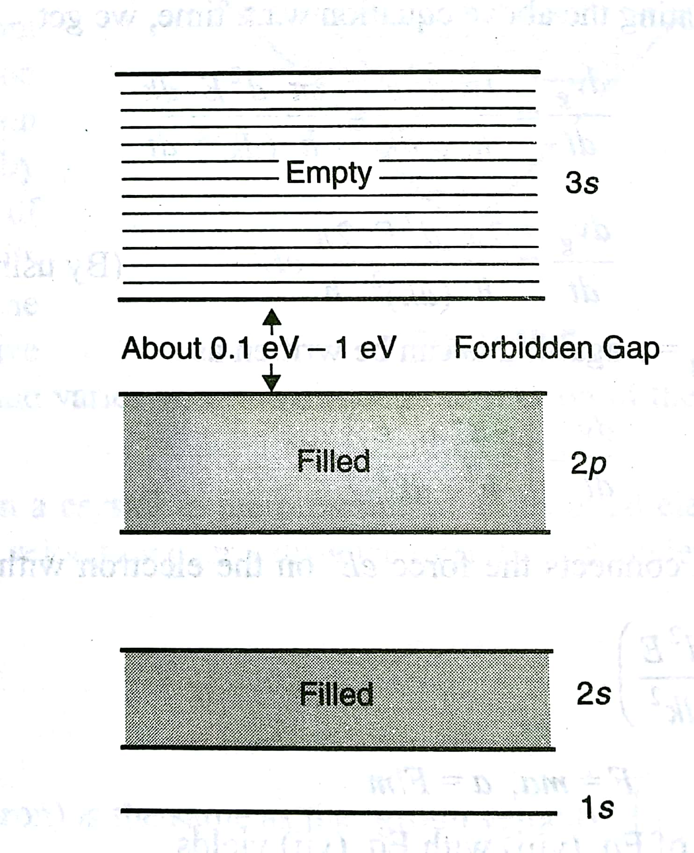
Semiconductors
In this case of semiconductors, the forbidden band between the highest filled valence band and the lowest empty conduction band is very narrow and is about 0.1 eV to 1 eV.
Thus, we can easily move the electrons from the highest filled band to the empty band. This can be achieved by thermal excitation or by applying electric field. For this reason, a free electron current can be obtained as a few electrons are available in the empty band.

Slide 20
Intrinsic versus Extrinsic Semiconductors
The conductivity of an intrinsic semiconductor can be increased significantly by adding impurities to it. By doing so we get impurity semiconductor which is also known as extrinsic semiconductor.
The introduction of the impurity to a semiconductor is called doping and the impurity which is introduced is called dopant.
The impurity atoms creates excess holes or the free electrons which control the conductivity of the extrinsic semiconductor.
Depending on the nature of the dopant and extrinsic semiconductor may be classified as an n-type or a p-type semiconductor.
If an element of group III is introduced to Ge or Si, excess holes are generated which results in a p-type semiconductor.
If an element of group V is introduced to Ge or Si, excess holes are generated which results in an n-type semiconductor.
The semiconductor in which the transformation of electrons to the conduction band and the generation of holes in the valence band are achieved purely by thermal excitation are called intrinsic semiconductors. Thus, this effect is temperature dependent and produces equal number of electron and hole carriers. The electrons and holes are called intrinsic charge carriers and the resulting conductivity is known as thermal conductivity.
In intrinsic semiconductor, the number of holes and electrons must be the same.
Intrinsic carrier concentration increases with increase in temperature.
Ge and Si are intrinsic semiconductor.

Slide 21
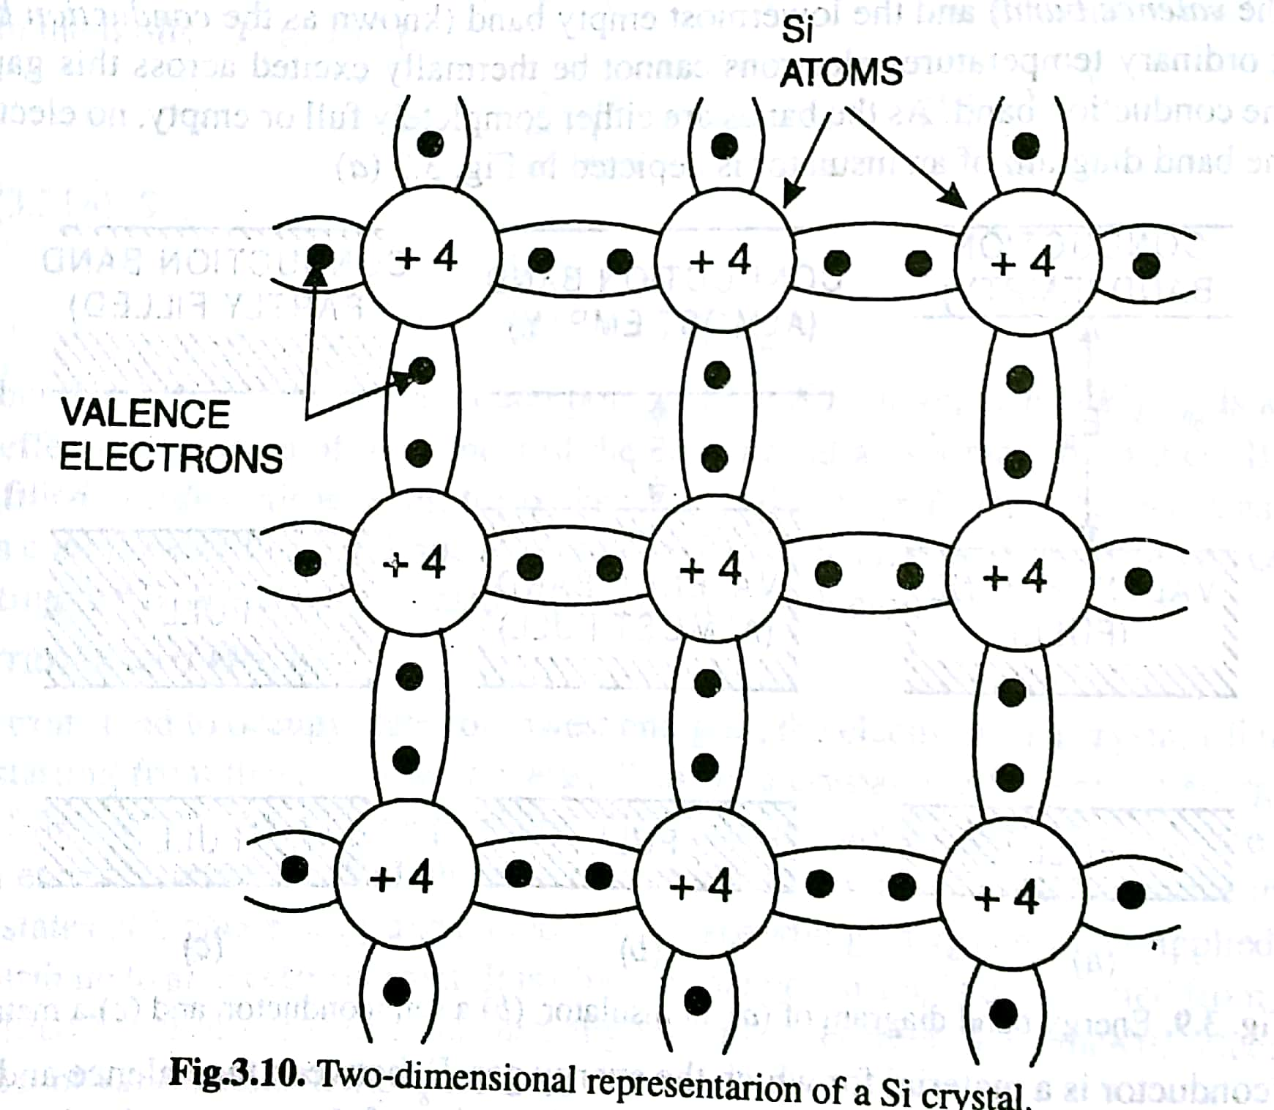
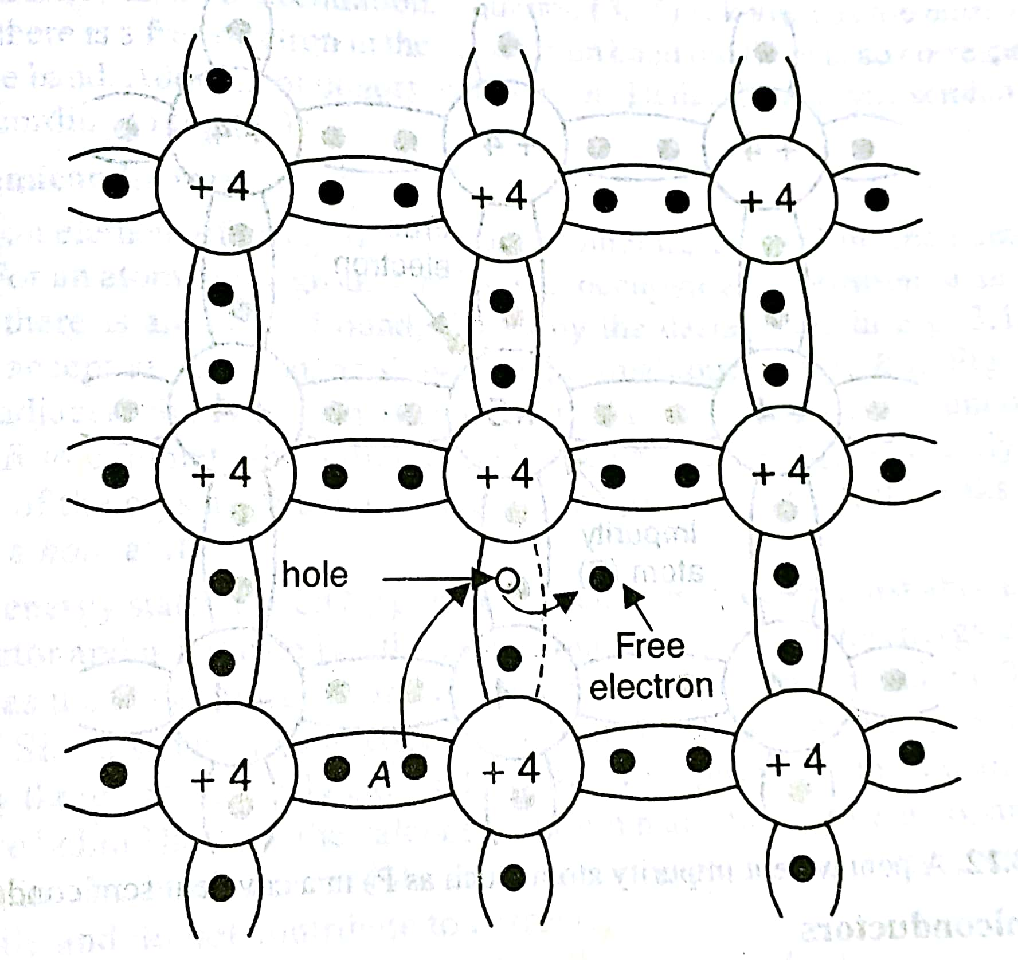
Conductivity in Ge and Si (Intrinsic Semiconductor)
Si or Ge is a group IV element of the periodic table and each atom has four valence electrons. The valence electrons of a particular atom are held by covalent bonds with the valence electrons of four neighboring atoms. When a valence electron gets sufficient energy, it breaks its covalent bond and become free. The vacancy left behind by the electron serves as a hole. Thus a free electron and a hole is created. An adjacent valence electron such as that in position A may acquire sufficient thermal energy and jump into the position of the hole to reconstruct the broken bond. However, in doing so, it breaks its own covalent bond, creating a new hole there. Thus effectively the hole moves to the position A and not only the free electron but also the hole it creates can move about the crystal.

Slide 22
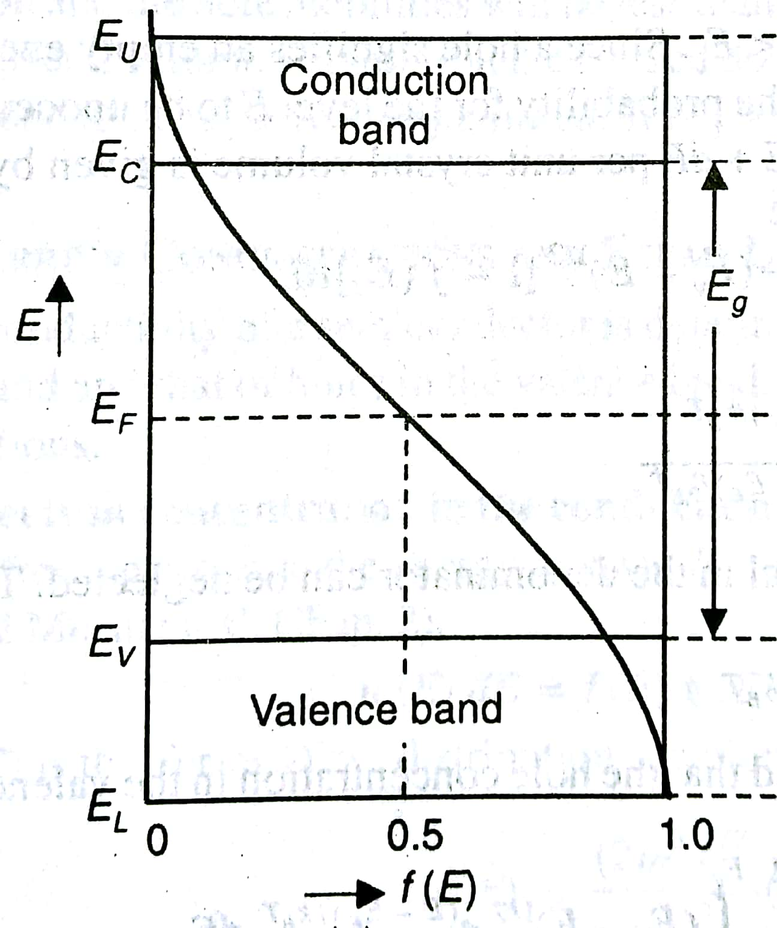
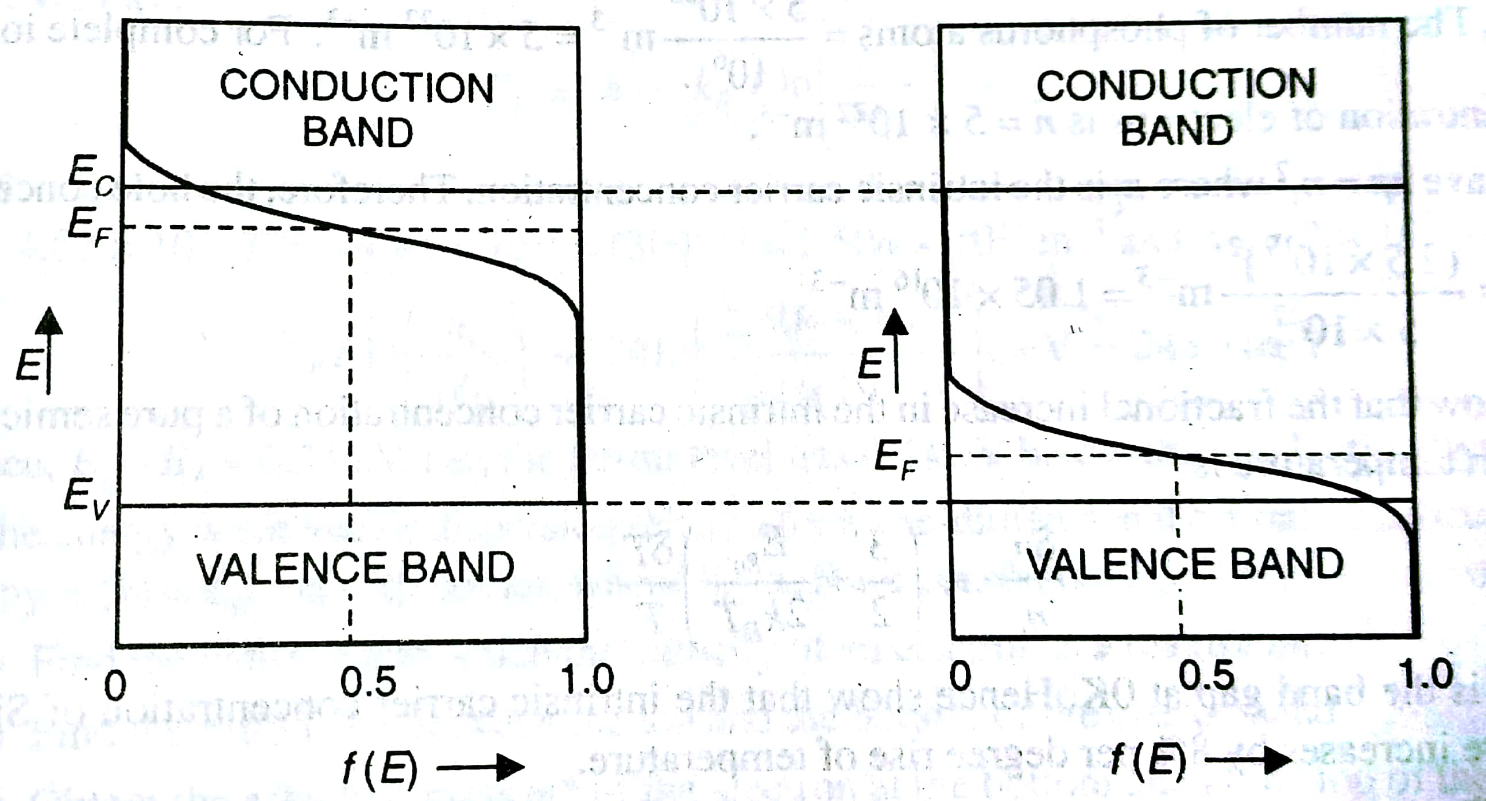
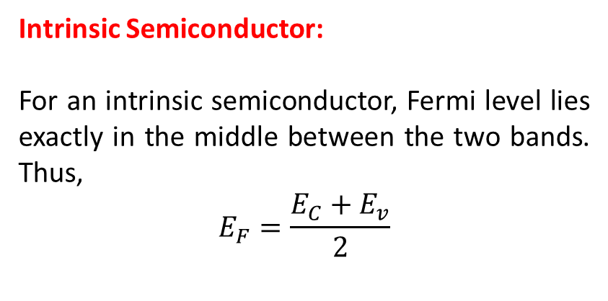
Fermi Levels
Intrinsic Semiconductor:
For an intrinsic semiconductor, Fermi level lies exactly in the middle between the two bands. Thus,
$$E_{F}=\frac{E_{C}+E_{v}}{2}$$
Extrinsic Semiconductor:
For an extrinsic semiconductor, the Fermi level lies near the conduction band of an n-type semiconductor and near the valence band of a p-type semiconductor.

Slide 23
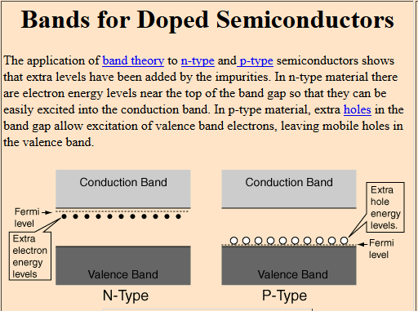

Slide 24

Direct and Indirect Semiconductors
A single electron is assumed to travel through a perfectly periodic lattice.
The wave function of the electron is assumed to be in the form of a plane wave moving, for example, in the x- direction with propagation constant k, also called a wave vector. The space-dependent wave function for the electron is
where the function U(k_{x}, x) modulates the wave function according to the periodicity of the lattice.

Slide 25
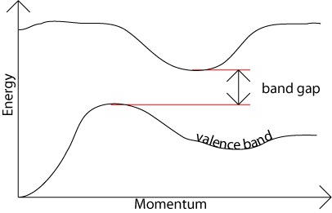
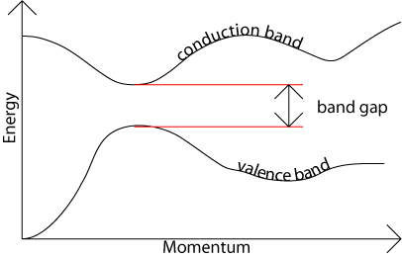
Direct and Indirect Band Gap Semiconductor
Direct Band:
The band gap represents the minimum energy difference between the top of the valence band and the bottom of the conduction band.
However, the top of the valence band and the bottom of the conduction band are not generally at the same value of the electron momentum. In a direct band gap semiconductor, the top of the valence band and the bottom of the conduction band occur at the same value of momentum, as in the schematic below.
Indirect Band:
In an indirect band gap semiconductor, the maximum energy of the valence band occurs at a different value of momentum to the minimum in the conduction band energy:
https://www.doitpoms.ac.uk/tlplib/semiconductors/direct.php

Slide 26
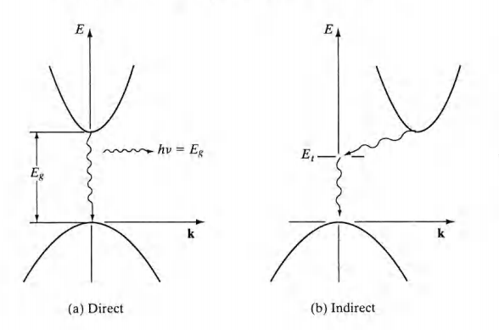
Direct and Indirect Semiconductors
GaAs has a minimum in the conduction band and a maximum in the valence band for the same k value (k = 0).
Si has its valence band maximum at a different value of k than its con­duction band minimum.

Slide 27
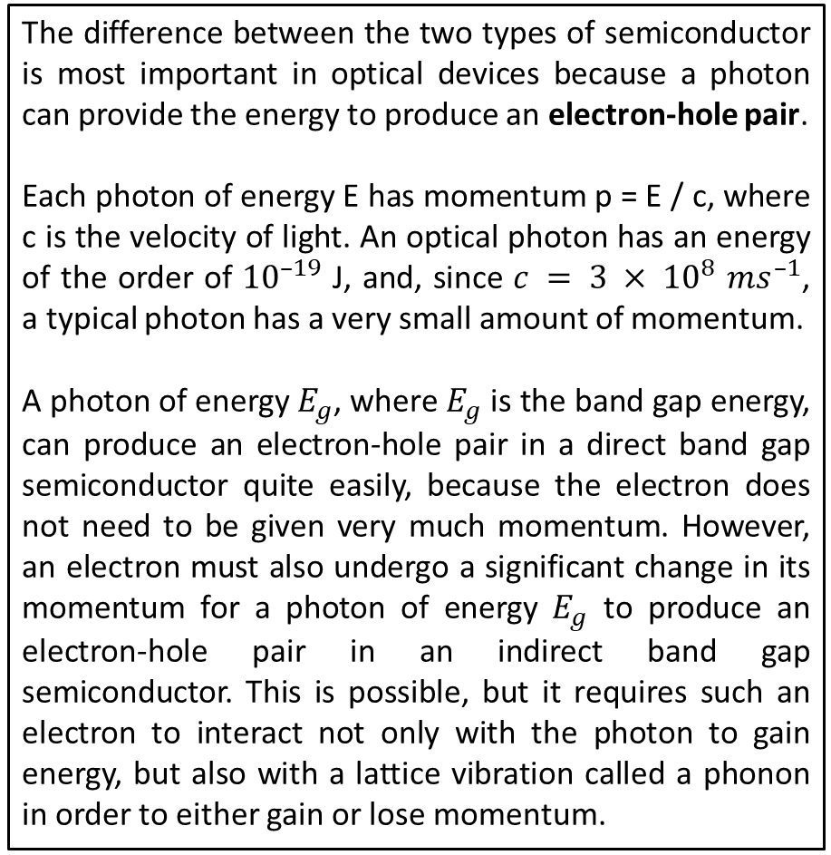
Direct and Indirect Band Gap Semiconductor
The difference between the two types of semiconductor is most important in optical devices because a photon can provide the energy to produce an electron-hole pair.
Each photon of energy E has momentum p = E / c, where c is the velocity of light. An optical photon has an energy of the order of ${10}^{–19}$ J, and, since $c = 3 × {10}^{8}$$ms^{–1}$, a typical photon has a very small amount of momentum.
A photon of energy $E_{g}$, where $E_{g}$ is the band gap energy, can produce an electron-hole pair in a direct band gap semiconductor quite easily, because the electron does not need to be given very much momentum. However, an electron must also undergo a significant change in its momentum for a photon of energy $E_{g}$ to produce an electron-hole pair in an indirect band gap semiconductor. This is possible, but it requires such an electron to interact not only with the photon to gain energy, but also with a lattice vibration called a phonon in order to either gain or lose momentum.
The indirect process proceeds at a much slower rate, as it requires three entities to intersect in order to proceed: an electron, a photon and a phonon. This is analogous to chemical reactions, where, in a particular reaction step, a reaction between two molecules will proceed at a much greater rate than a process which involves three molecules.
The same principle applies to recombination of electrons and holes to produce photons. The recombination process is much more efficient for a direct band gap semiconductor than for an indirect band gap semiconductor, where the process must be mediated by a phonon.
As a result of such considerations, gallium arsenide and other direct band gap semiconductors are used to make optical devices such as LEDs and semiconductor lasers, whereas silicon, which is an indirect band gap semiconductor, is not. The table in the next section lists a number of different semiconducting compounds and their band gaps, and it also specifies whether their band gaps are direct or indirect
https://www.doitpoms.ac.uk/tlplib/semiconductors/direct.php

Slide 28
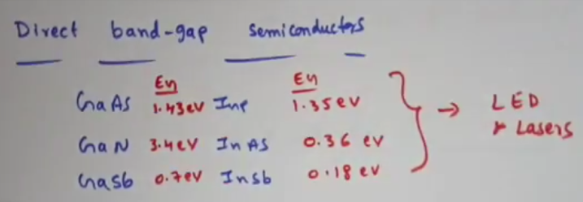
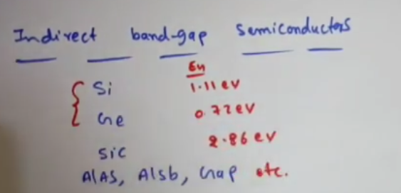
Direct and Indirect Band Gap Semiconductor
 | Material | Direct / Indirect Bandgap | Band Gap Energy at 300 K (eV)
Elements | C (diamond) Ge Si Sn (grey) | Indirect Indirect Indirect Direct | 5.47 0.66 1.12 0.08
Groups III-V compounds | GaAs InAs InSb GaP GaN InN | Direct Direct Direct Indirect Direct Direct | 1.42 0.36 0.17 2.26 3.36 0.70
Groups IV-IV compounds | α-SiC | Indirect | 2.99
Groups II-VI compounds | ZnO CdSe ZnS | Direct Direct Direct | 3.35 1.70 3.68
https://www.doitpoms.ac.uk/tlplib/semiconductors/direct.php

Slide 29
Direct and Indirect Semiconductors
The band structure of GaAs has a minimum in the conduction band and a maximum in the valence band for the same k value (k = 0).
On the other hand, Si has its valence band maximum at a different value of k than its con­duction band minimum.
Thus an electron making a smallest-energy transition from the conduction band to the valence band in GaAs can do so without a change in k value;
on the other hand, a transition from the minimum point in the Si conduction band to the maximum point of the valence band requires some change in k.
Thus there are two classes of semiconductor energy bands; direct and indirect.
It can be seen that in an indirect transition, involving a change in k, requires a change of momentum for the electron.

Slide 30
Direct and Indirect Semiconductors
In a direct semiconductor such as GaAs, an electron in the conduction band can fall to an empty state in the valence band, giving off the energy differ­ence E_{g} as a photon of light.
On the other hand, an electron in the conduc­tion band minimum of an indirect semiconductor such as Si cannot fall directly to the valence band maximum but must undergo a momentum change as well as changing its energy.
For example, it may go through some defect state (E_{t}) within the band gap.
In an indirect transition which involves a change in k, part of the energy is generally given up as heat to the lattice rather than as an emitted photon.
This difference between direct and indirect band struc­tures is very important for deciding which semiconductors can be used in de­vices requiring light output.
For example, semiconductor light emitters and lasers generally must be made of materials capable of direct band-to-band transitions
or of indirect materials with vertical transitions between defect states.

Slide 31
MCQs
https://nptel.ac.in/content/storage2/courses/112108150/pdf/MCQs/MCQ_m14.pdf
https://www.sanfoundry.com/engineering-physics-questions-answers-freeing-electron-theory/

